Slide 1


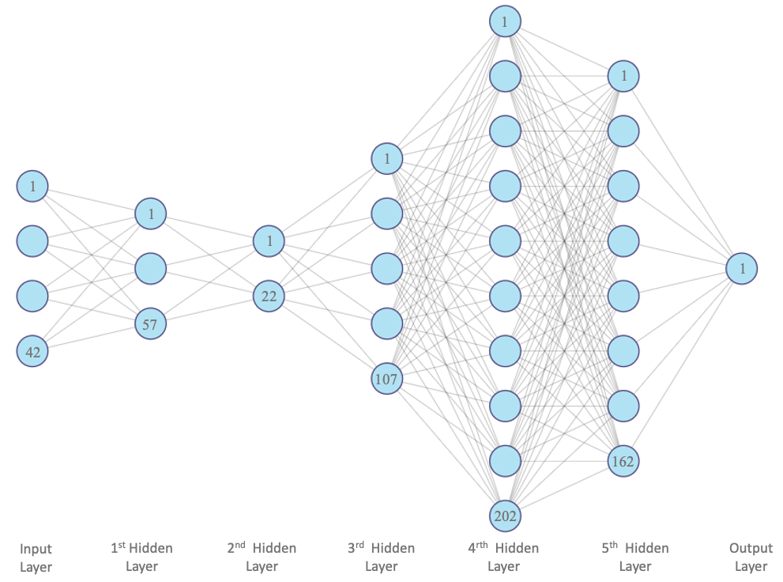
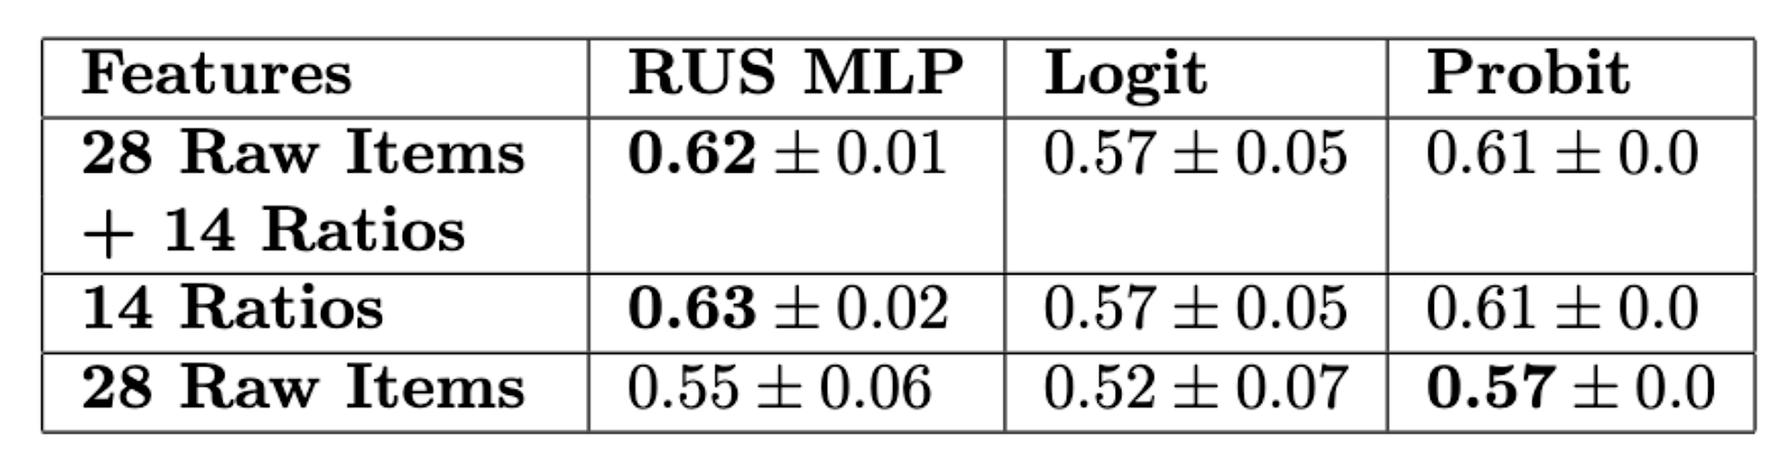
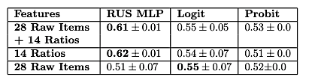

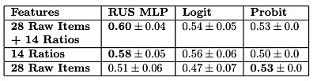
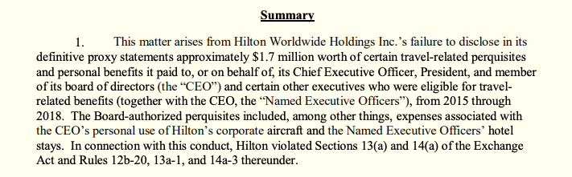

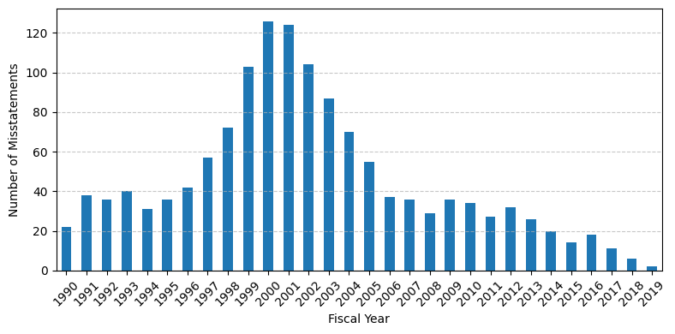
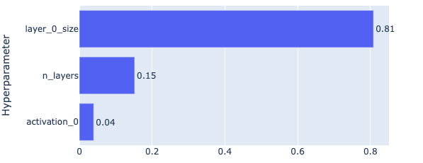
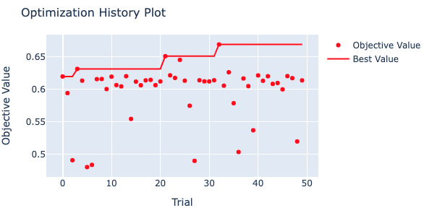
Leveraging Deep Learning for Accounting
Fraud Detection*
Victoria Gonzalez¹, Sai Teja Reddy², Chitral Patil², Haimonti Dutta^{1,2}
{vg38,saitejar,chitralp,haimonti}@buffalo.edu
Introduction
Fraudulent financial reporting encompasses deliberate misstatements or omissions in financial statements, aiming to mislead stakeholders and regulators, resulting in a breach of Generally Accepted Accounting Principles (GAAP).
Multilayer Perceptron (RUS MLP)
Results
MLP model outperforms Logit and Probit models in terms of AUC scores across 10 randomized training trials.
Three under-sampling ratios (minority vs majority class) were tested: 1:1, 1:2, and 1:3.
MLP - a feed-forward artificial neural network.
Comprises of fully connected neurons with nonlinear activation functions like logistic, tanh, or ReLU.
Structured into three layers: the input, hidden layers and output layer
Fig 1. 10-K Annual Filing
Table 1. AUC results with RUS ratio 1:1
This research introduces a a Multi-Layer Perceptron (MLP) with Random Under-Sampling (called RUS MLP) for detecting accounting fraud, leveraging publicly available financial data extracted from 10-K filings.
Fig 4. RUS MLP Architecture used in empirical analysis
Table 2. AUC results with RUS ratio 1:2
Optimization
The Optuna** framework was used for hyperparameter tuning. Three parameters were optimized (# of layers, # of neurons in each layer, and activation functions. The number of neurons of the 1st layer was most relevant for higher performance.
Table 3. AUC results with RUS ratio 1:3
Fig 2. Accounting and Auditing Enforcement Releases
Conclusion
This study investigates the implementation of a RUS MLP for detecting accounting fraud in out-of-sample financial data.
Employing Optuna, we optimized the MLP architecture, identifying the best hyperparameters for the model.
Our analysis reveals that deep neural network models have the potential to surpass the AUC of traditional linear models.
* This work has been accepted for presentation at the International Conference on Business Analytics at SUNY Fredonia.
Fig 3. Misstatements distributions by year
Fig 5. Hyperparameter importance and AUC evolution over different trials.
** Optuna: A Next-generation Hyperparameter Optimization Framework, Akiba et al. 2019.
¹Department of Management Science and Systems
²Institute for Artificial Intelligence and Data Science The State University of New York at Buffalo
Buffalo, NY 14221

